Slide 1
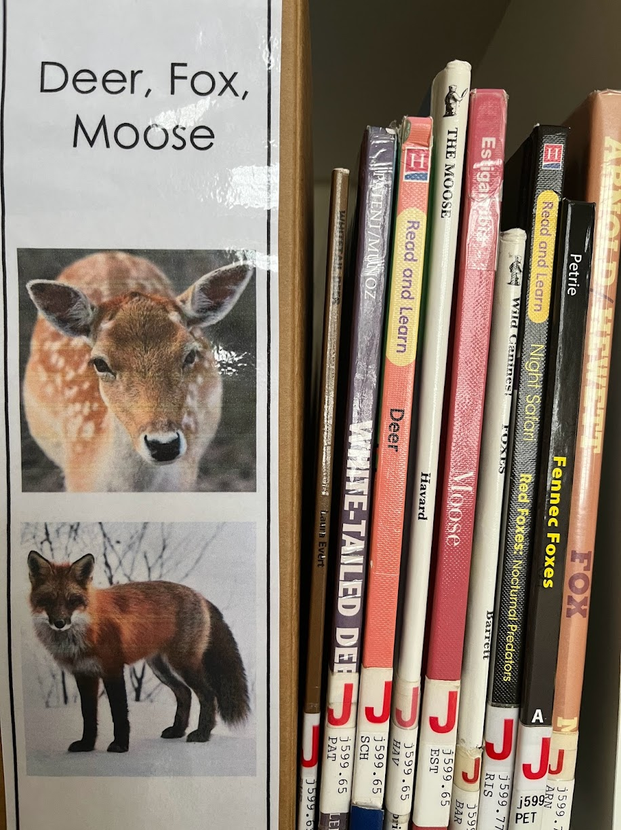
Purchase my nonfiction labels here!
All you need to do is purchase cardboard or plastic magazine files. There are some sample sizes on the next few slides so you can try them.
Options Included: Whole number Dewey, Extended number Dewey, and no Dewey

Slide 2
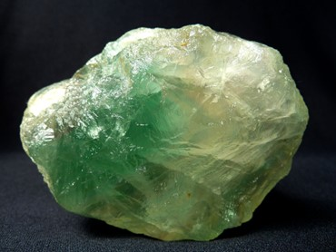
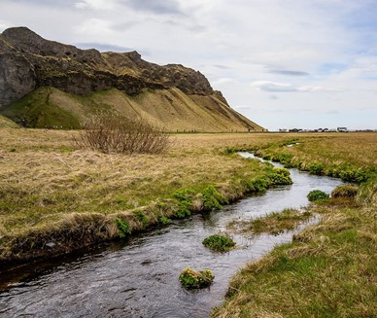
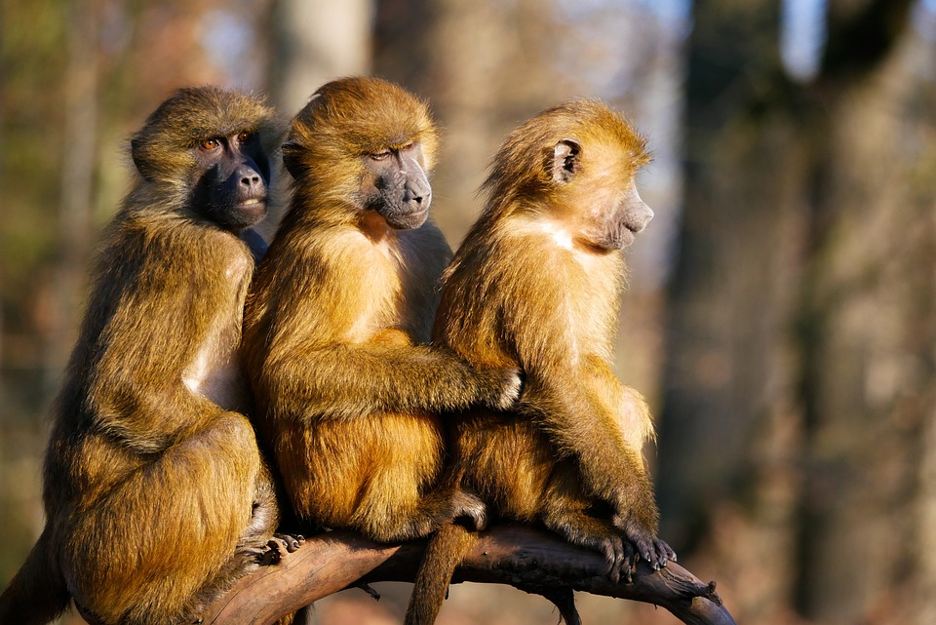
Space
Weather
Rocks and Minerals
Science
Dinosaurs
Biomes
Plants
Animals

Slide 3
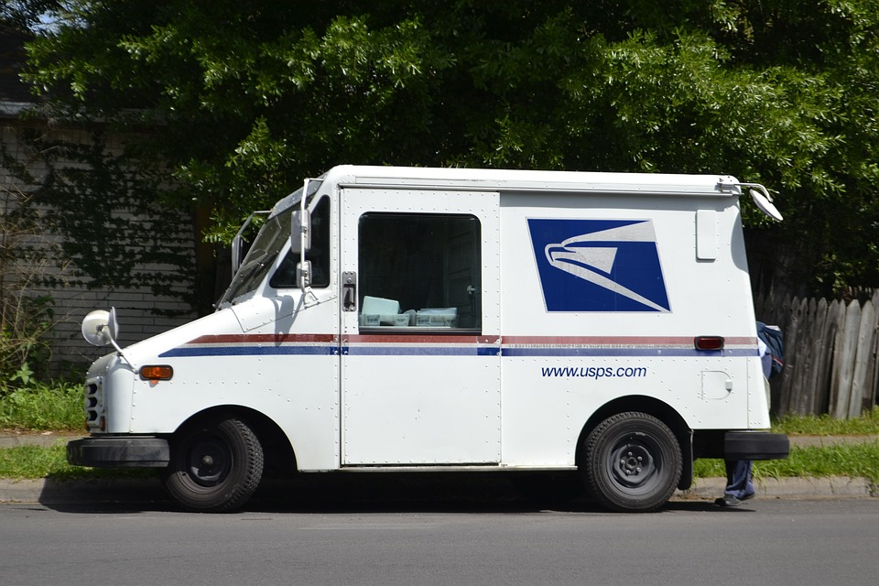
Community Jobs
Military

Slide 4
Community Jobs
Military

